Slide 1
Knowledge and practice standards
for
graduate language and literacy teachers

Slide 2
A sub-project of the Consolidated Literacy Working Group of the Primary Teacher Education (PrimTEd) project of the DHET’s

Slide 3
Brief of the literacy working group
Literacy teaching core competency standards
A literature review
Analysis of the competencies required by new teachers [from the literature review]
Compare these with those being developed in universities in actual (or planned) courses/ modules

Slide 4
Develop our own draft standards, consult widely and revise as necessary
Develop competency assessment items with the Assessment Working Group

Slide 5
Our notion of standards
Their purpose is to make something else happen – children learning to read and write (that children create meaning using texts).
Teacher knowledge and practice standards are statements that describe what a teacher needs to know and be able to do to carry out their core function professionally and effectively.

Slide 6
Substantial evidence-based information exists on what the standards should cover.
Have obvious HEI Initial Teacher Education reading and writing curriculum revision implications.
See our document: Towards competency standards for language and literacy teachers

Slide 7
Process – steps developing these standards
The literature review
The mapping of standards
The drafting of seven standards
The editing, refining and condensing to three standards
First consultation
Second consultation
Authorisation, release and distribution

Slide 8
1
The literature review
Output – a brief annotated bibliography
https://www.jet.org.za/clearinghouse/primted/standards/literacy-teacher-standards
Usefulness of the examples

Slide 9
Examples of complex, detailed standards

Slide 11
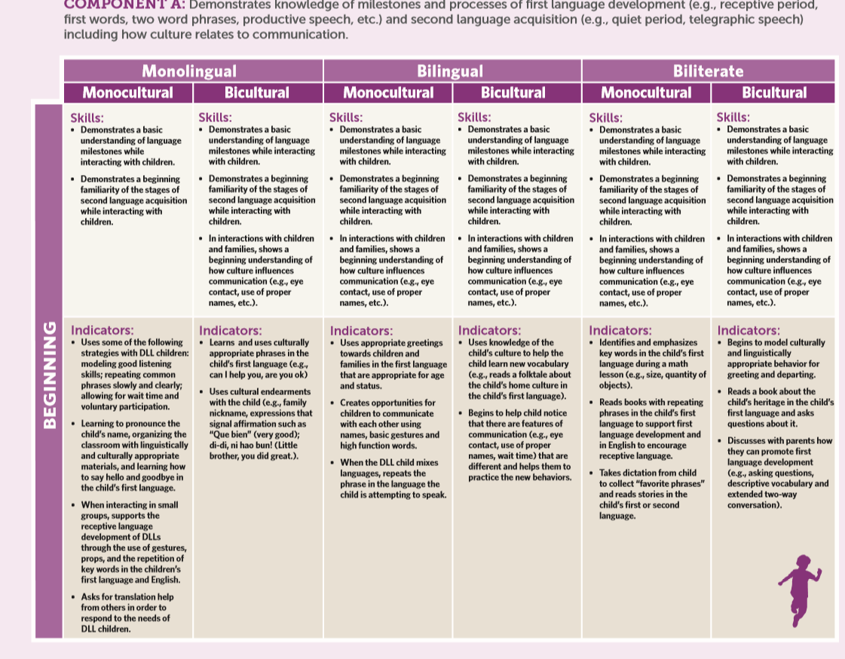

Slide 12
The giant spreadsheet
2
The mapping of standards

Slide 13
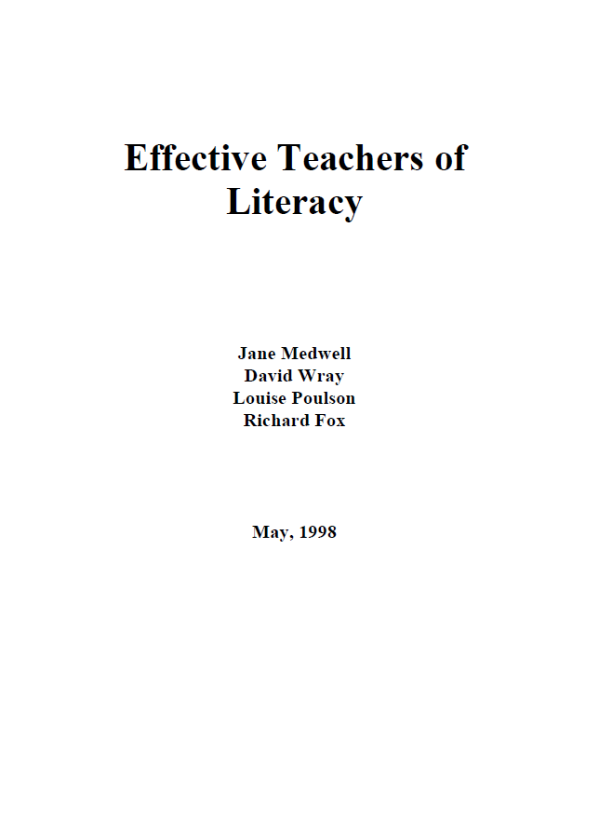
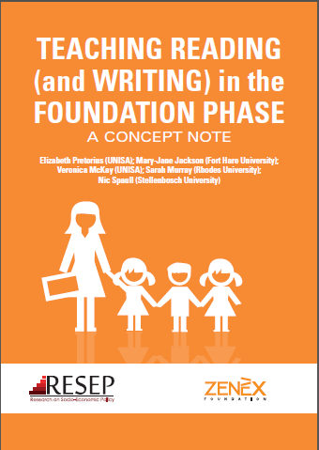
Influences
Lots of USA standards
Medwell et al (1998) categories
The “RESEP/Zenex” curriculum

Slide 14
Standards nomenclature and architecture
Our decision on using the SAQA standards format
See our document: Towards a common terminology and architecture for standards developed by PrimTEd for literacy and mathematics ITE
https://www.jet.org.za/clearinghouse/primted/standards/literacy-teacher-standards

Slide 15
No generic categories – only those relating to literacy teaching
Specific – not broad principles
Concise and not overcomplicated (c.f. International Literacy Association standards of 2016)
Linguistically and conceptually accessible
Not graded in terms of ratings of proficiency or in terms of teacher experience, etc. Should be for all graduating teachers.

Slide 16
